Slide 1
CTS 6319 Cyber Security: Measurement and Data Analysis
Dr. Elias Bou-Harb
ebouharb@fau.edu EE 503B
Office hours: Mondays 4-6pm

Slide 2
Material
On Canvas
OSI/TCP/IP (for Lecture 2)
TCP/IP: Reading Except Chapter 6 (for Lecture 2)
Networking 101: Very good read
Research Paper: Can We Identify NAT Behavior by Analyzing Traffic Flows?

Slide 3
Networking 101
Open system interconnection (ISO/OSI reference model)
Data communication standards
Defines processes and tasks of network hosts
A layered Architecture
Easier to understand
Easier to debug
Easier to expand

Slide 4
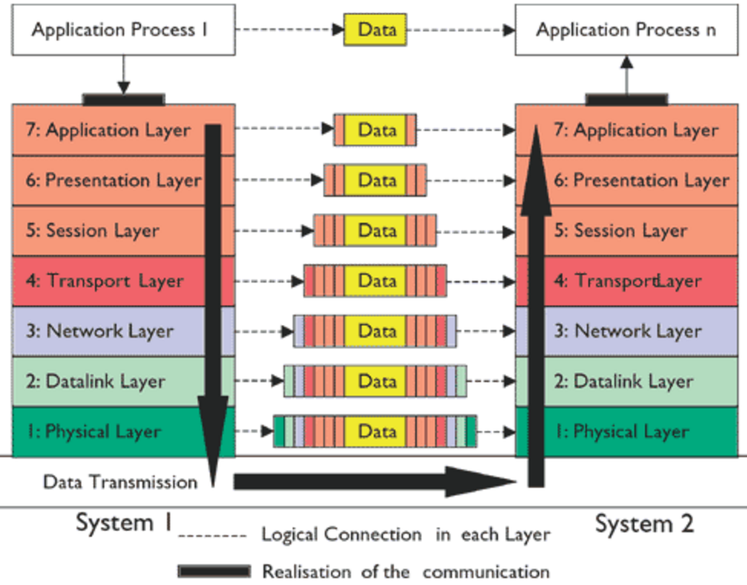
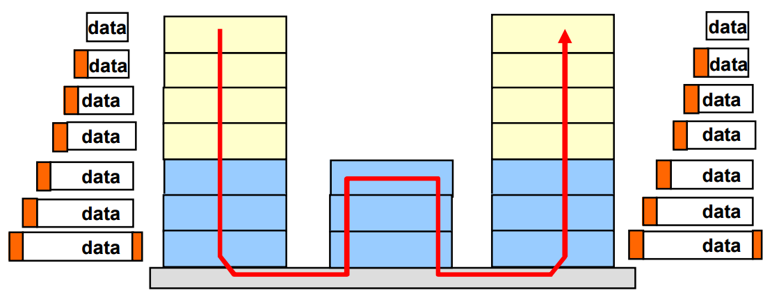
Networking 101
All
People
Seem
To
Need
Data
Processing

Slide 5
Networking 101
Application layer
The 7th layer
End-User Interaction
Application layer protocols
Name a few?

Slide 6
Networking 101
Presentation layer
The 6th layer
Helps map application layer protocols to lower level layers
Provides common formats that the lower levels can understand
Compression/Encryption of application information is accomplished

Slide 7
Networking 101
Session layer
The 5th layer
Establishes the concept of a session between two communicating hosts
Crucial for network investigation
Mapping of sessions
Measuring traffic/protocols/anomalies
Could be considered as virtual connections between applications

Slide 8
Networking 101
Transport layer
The 4th layer
Decision between connection-oriented and connectionless
Various functionalities
Segmentation
Error control
Multiple session handling

Slide 9
Networking 101
Network layer
The 3th layer
Provides logical addressing to route packets
Routing algorithms
Buffering and queuing theories
Encapsulated data into the notion of packets

Slide 10
Networking 101
Data-link layer
Allows devices to access the network
Introduces the concept of physical addresses
Prepares data to be sent over network media
Adapts to the physical medium

Slide 11
Networking 101
Physical layer
Deals with putting the frame on the wire
Establishes hardware requirements

Slide 12
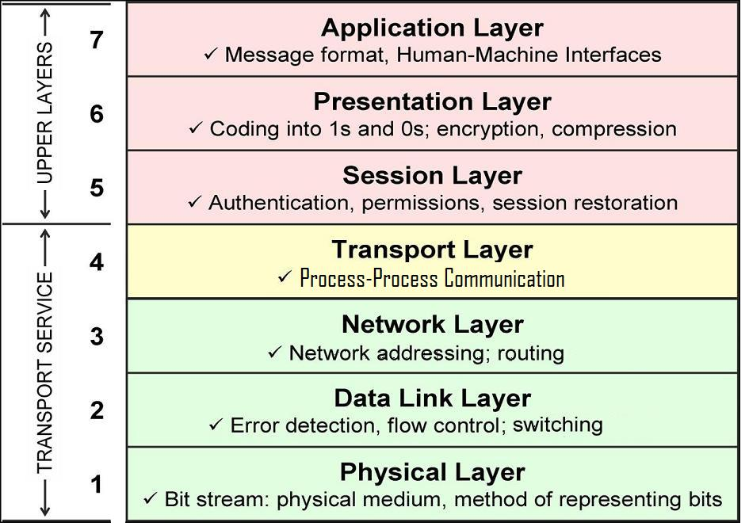
Networking 101-The big picture

Slide 13
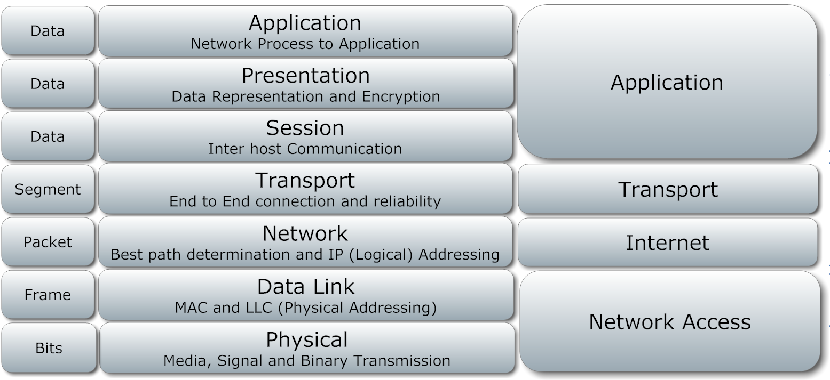
Networking 101-Relation to TCP/IP
OSI
TCP/IP

Slide 14
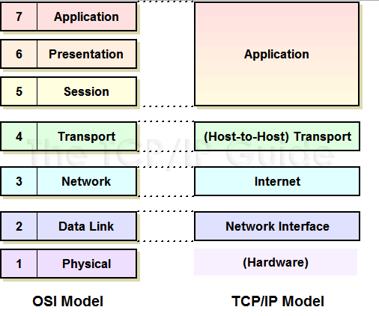
Networking 101- TCP/IP Model
A DoD initiative
Realizes the ISO/OSI Model
Network Reliability, a main concern

Slide 15
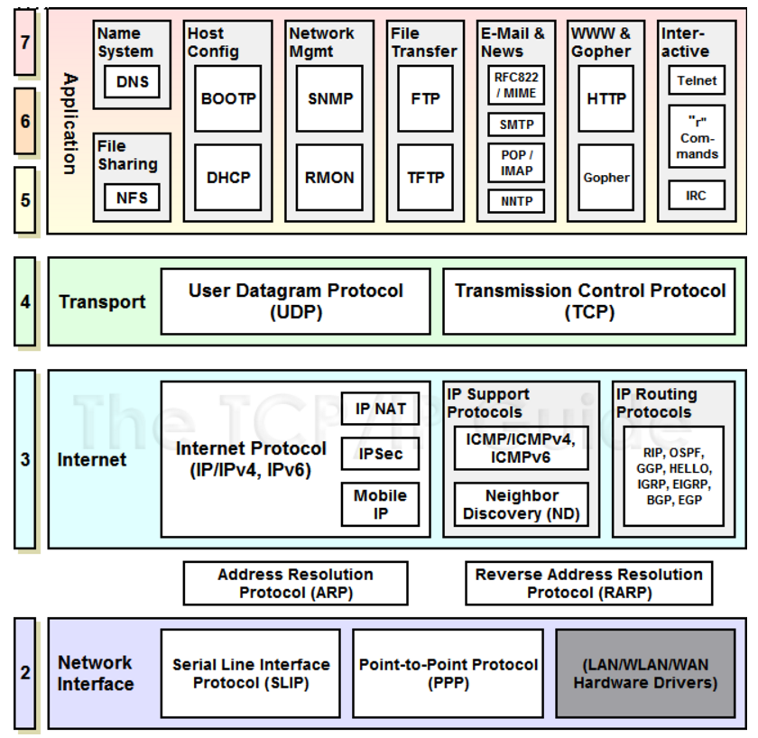
Networking 101- TCP/IP Model & Protocols

Slide 16
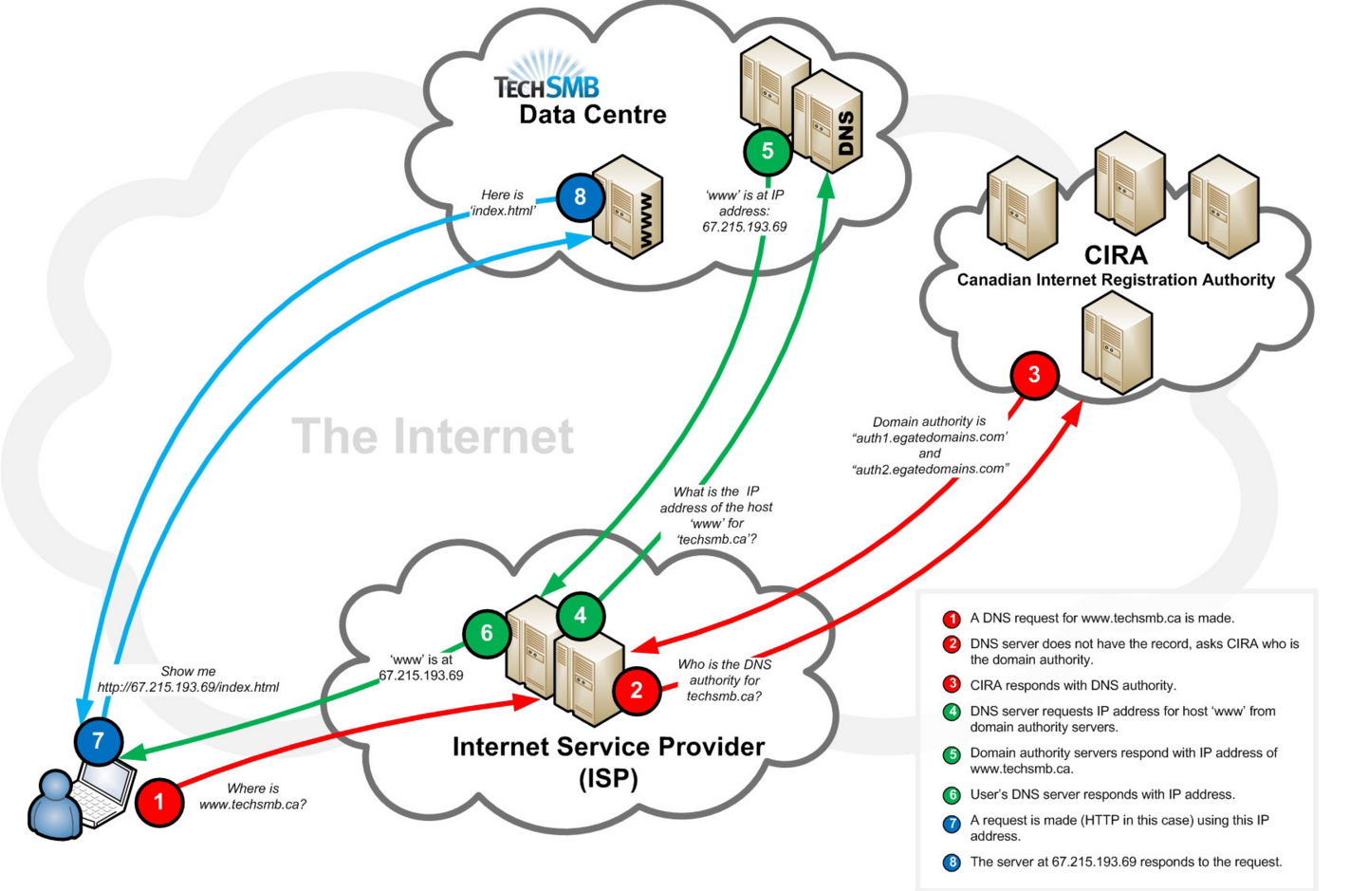
Networking 101- DNS

Slide 17
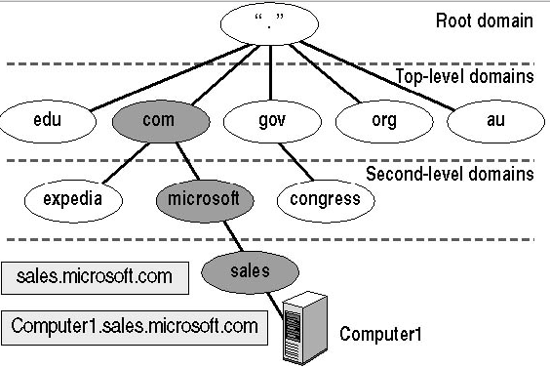
Networking 101- DNS

Slide 18
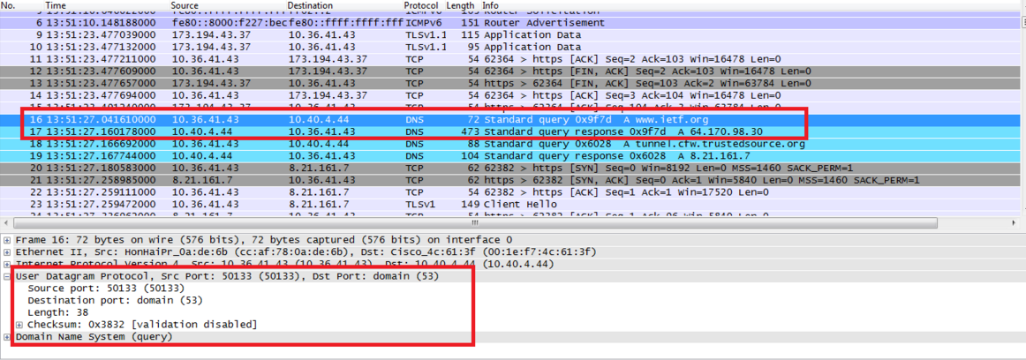
Networking 101- DNS

Slide 19
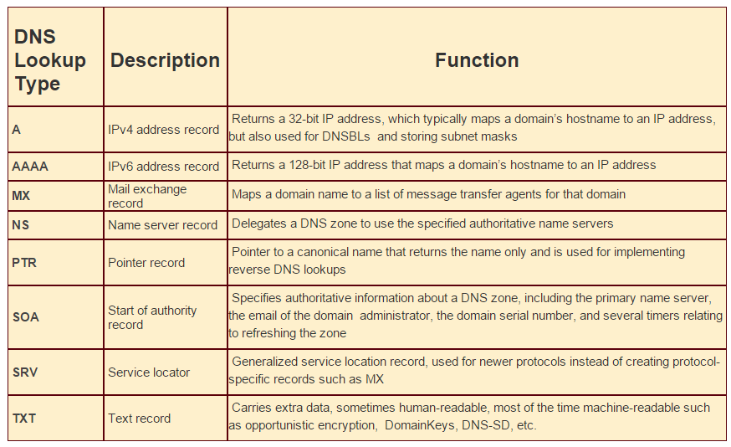
Networking 101- DNS
DNS Query Type
ANY ??

Slide 20
Networking 101- DHCP
Dynamic Host Control Protocol
Permits automatic IP configuration assignment to network hosts
IP address
Default Gateway
DNS Servers
Etc..

Slide 21
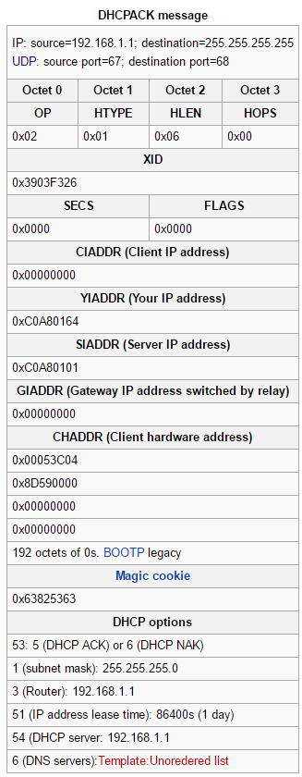
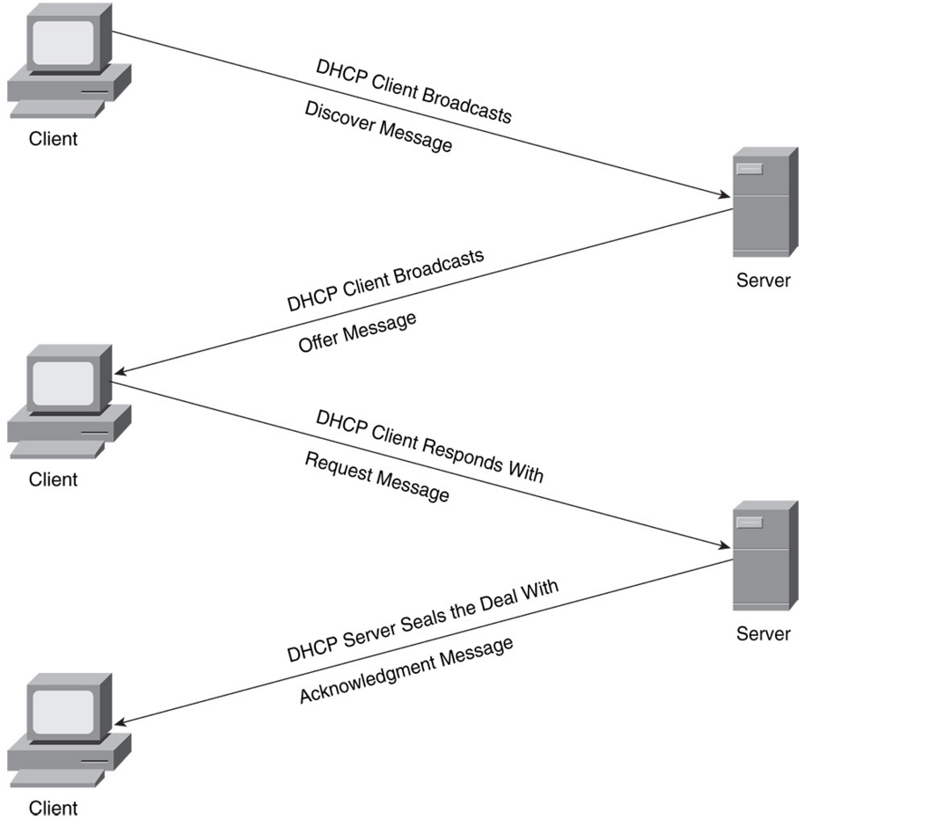
Networking 101- DHCP

Slide 22
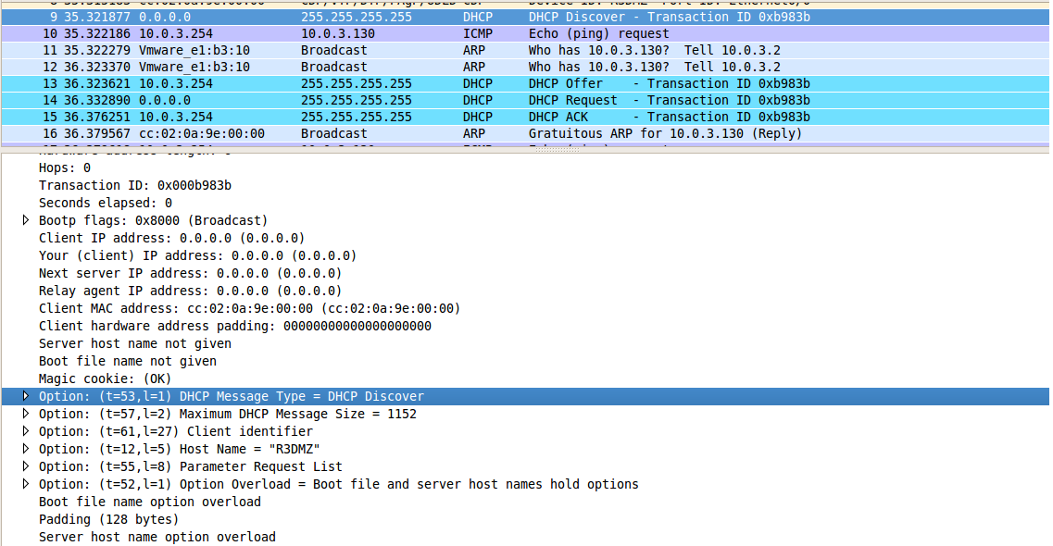
Networking 101- DHCP
Dynamic Host Control Protocol
Permits automatic IP configuration assignment to network hosts
IP address
Default Gateway
DNS Servers
Etc..

Slide 23
Networking 101- UDP
User Datagram Protocol
Connectionless, non-guaranteed
Does not offer retransmission for reliable delivery, packetization and reassembly, flow control, congestion avoidance, etc.
No session setup
Forces the application to handle errors
Fast, often used for real-time applications

Slide 24
Networking 101- TCP
Transport Control Protocol
Connection-oriented, guaranteed delivery
Offers retransmission, packetization and reassembly, flow control, congestion avoidance, etc.
Session establishment/termination, packets’ acknowledgement

Slide 25
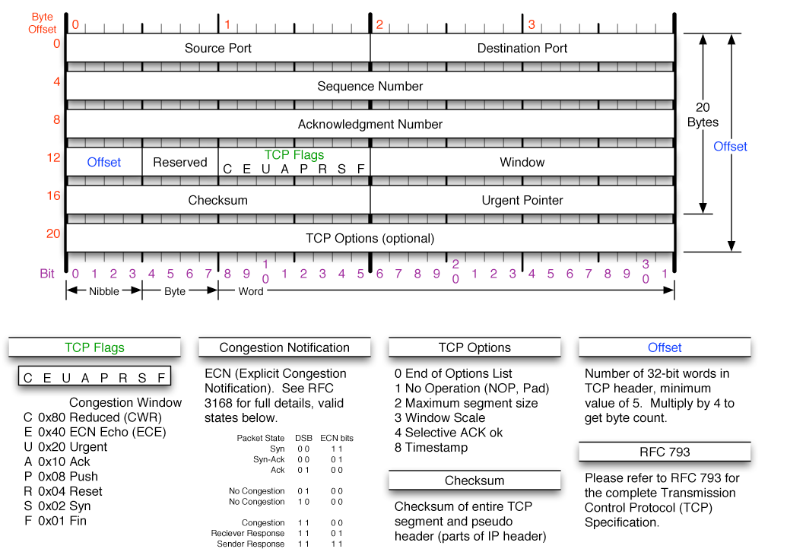
Networking 101- TCP Header

Slide 26
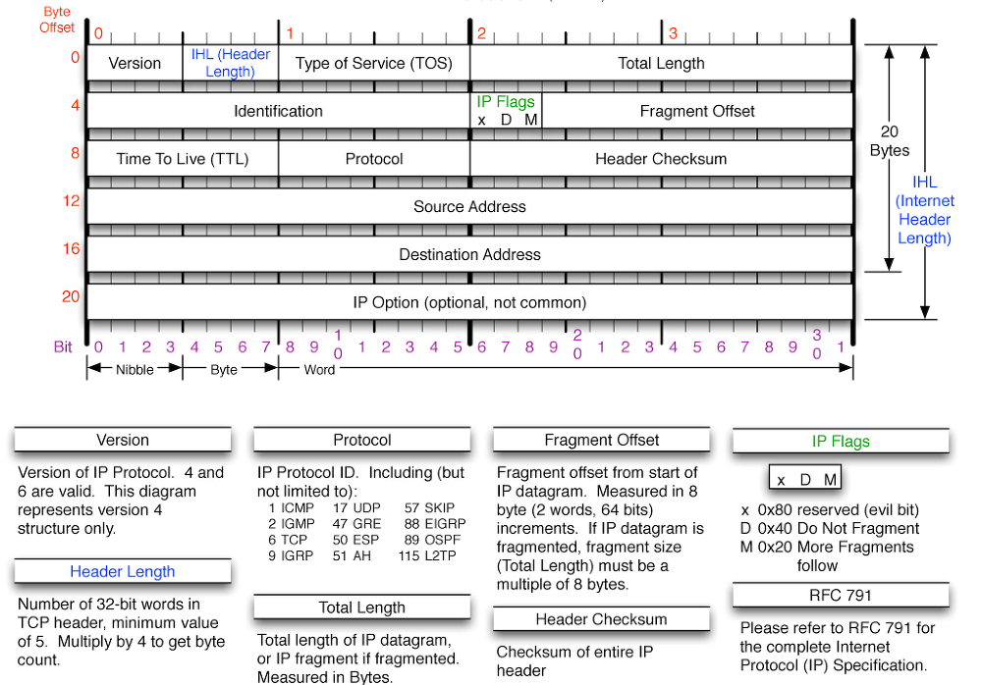
Networking 101- IP Header

Slide 27
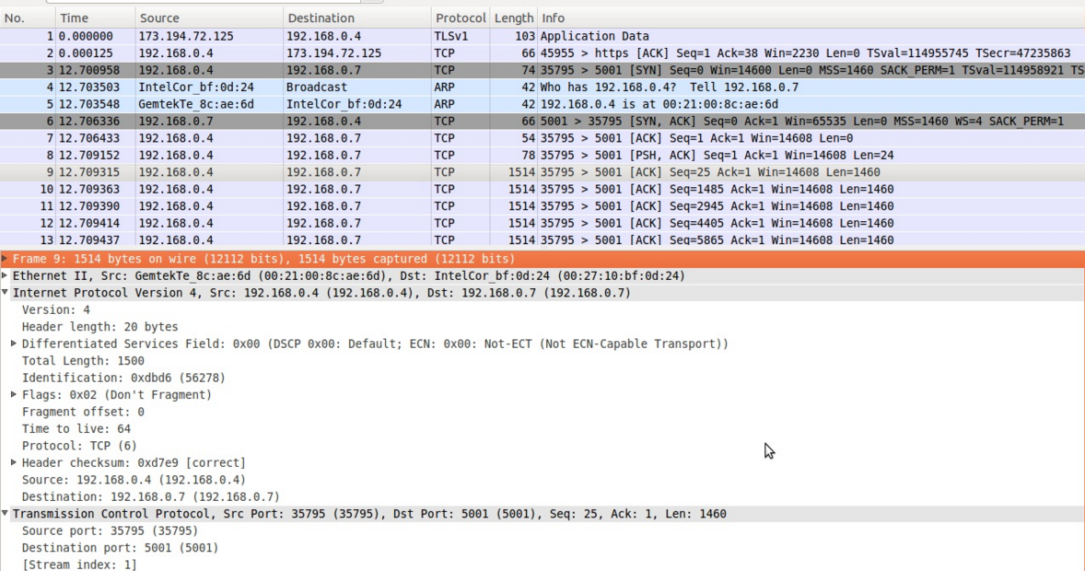
Networking 101- IP Header

Slide 28
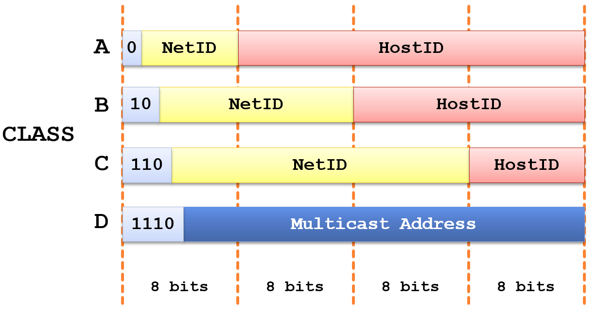
Networking 101- IP addressing

Slide 29
Networking 101- Recall Binary<->Decimal
What is 40 in binary?
What is 01011010 in decimal?

Slide 30
Networking 101- IP addressing
Private IP addresses
Used only in local area networks
Do not have to be paid for
Ranges:
192.168.0.0->192.168.255.255
172.16.0.0->172.31.255.255
10.0.0.0->10.255.255.255
Public IP addresses
Routable, Internet-accessible
Allocated by the Internet Assigned Numbers Authority (IANA)

Slide 31
Networking 101- IP NAT/PAT
Network address translation/Port address translation
Allow internal hosts to access Internet services using 1 (or few) public IP addresses
Can be generalized to access any network from another network
Procedure: Source IP address is substituted with NAT Router IP address
Source Port is saved in NAT Router to be used in reply packets
https://tools.ietf.org/html/rfc2663 RFC Documentation

Slide 32
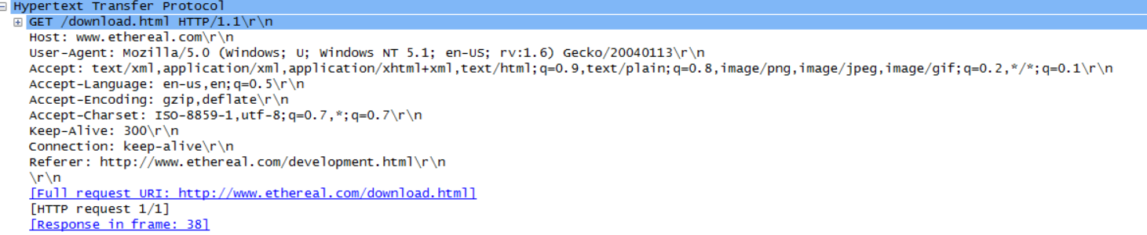
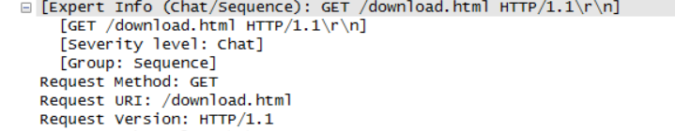
HTTP Packets

Slide 33
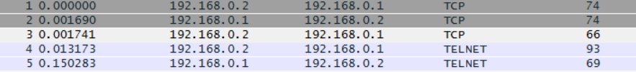
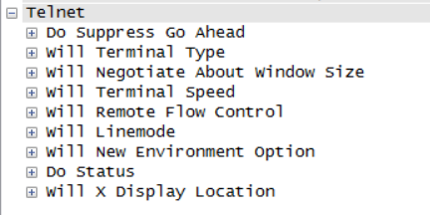
Telnet Packets
TCP packets?

Slide 34
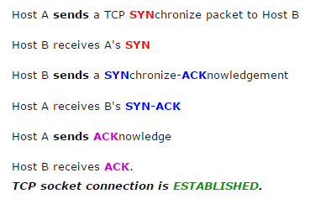
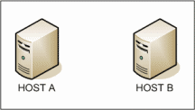
TCP 3-way Handshake

Slide 35
Telnet Packets
TCP packets?

Slide 36
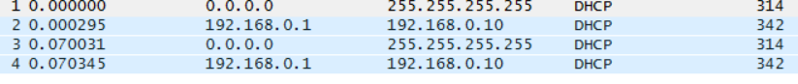
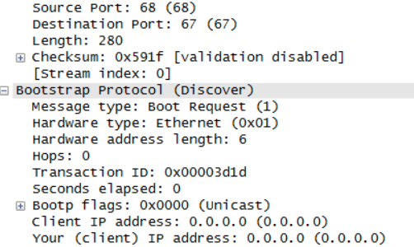
DHCP Packets

Slide 37
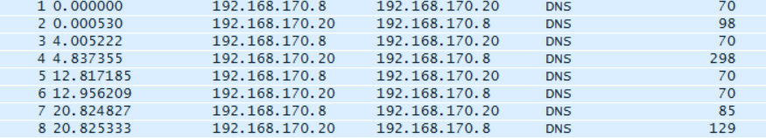
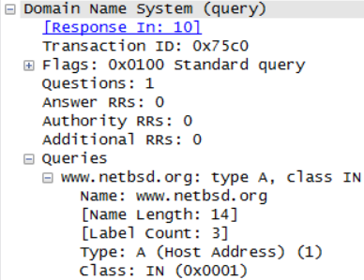
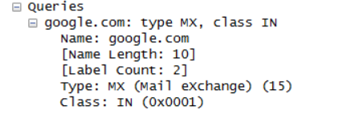
DNS Packets

Slide 38
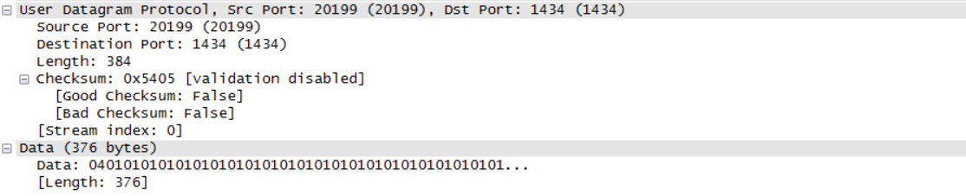
?

Slide 39
?

Slide 40
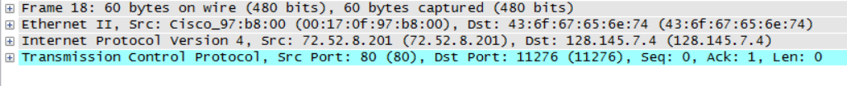
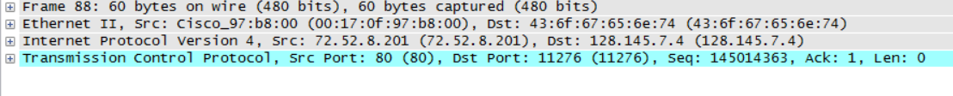
?

Slide 41
To Do:
Play around with Wireshark (https://www.wireshark.org/)
Download sample packets (.pcap) files from https://wiki.wireshark.org/SampleCaptures
More Stuff!
MALWARE ANALYSIS AND INCIDENT RESPONSE TOOLS FOR THE FRUGAL AND LAZY (http://postmodernsecurity.com/2015/09/11/malware-analysis-and-incident-response-tools-for-the-frugal-and-lazy/)
More tools (http://www.gfi.com/blog/the-top-20-free-network-monitoring-and-analysis-tools-for-sys-admins/)
Traffic analysis libraries (http://jnetpcap.com/, http://www.pcap4j.org/) (http://www.tcpdump.org/, http://research.wand.net.nz/software/libtrace.php)

Slide 42
CTS 6319 Cyber Security: Measurement and Data Analysis
Dr. Elias Bou-Harb
ebouharb@fau.edu EE 503B
Office hours: Mondays 4-6pm
http://faculty.eng.fau.edu/ebouharb/

